Slide 1
CvsP1
File created on: 3/15/2022 10:11:17 PM

Slide 2
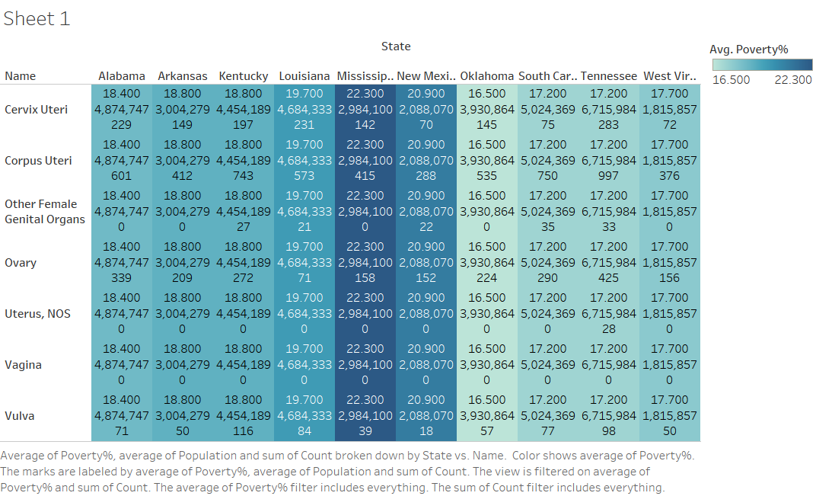

Slide 3
